Slide 1



TECH PHANTOMS
AMARJIT DEY(LEADER) PH.NO.9883621798
REG.NO. 20BEC0297
SUJITH REDDY PH.NO.9441859082
REG.NO.20BEC0672
MEET THE TEAM
MATTUPALLI NIKITHA PH.NO.8688348201
REG.NO.20BEC0011

Slide 2

Domain: open innovation
WEB APPLICATION FOR UNHINDERED EMERGENCY SERVICES
The new standard of patient care

Slide 3

Present Problem
ABSTRACT
The "Patient-Centric" Approach
Goals
How will it work

Slide 4

PRESENT PROBLEMS

Slide 5

STUCK IN TRAFFIC
Promptness and time play a crucial role in ambulance services. A person's life is dependent on your arrival. One of the most common reasons for arriving late at the patient's house is because of being stuck in traffic. Traffic is not something that is in your control, agreed. Most people give way to the ambulance, but there are times when the ambulances get stuck in the traffic.
If you have been working on an ambulance for a long time then you must already be familiar with the city and roads. You must already know what are the peaks of hours of traffic for a particular area. So why not use to reach on time. As with advancement in technology, you can now find maps to the unknown area with Google maps.
These maps also tell you beforehand if you would experience traffic in a particular area. It also provides you with alternate routes. So follow the application and use your local knowledge to avoid huge traffic pits and safely transport the patient to the hospital.

Slide 6
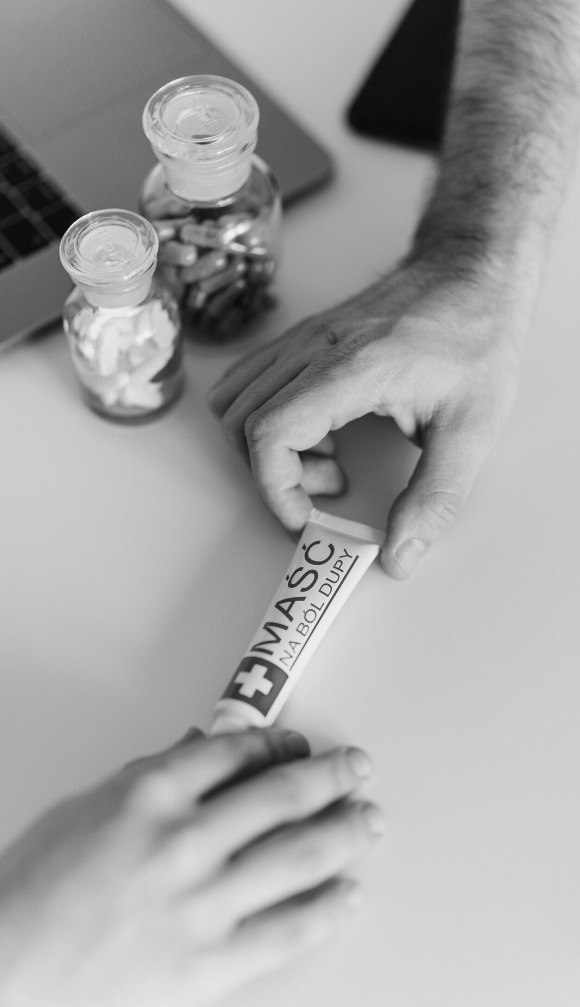


LACK OF BEDS BY THE TIME THEY REACH HOSPITAL
leads to loss of time, which parallelly puts the patient's life in danger.
Adds up to the trauma of the already suffering family.
Often, people get infuriated and might cause damage to the hospital property.

Slide 7
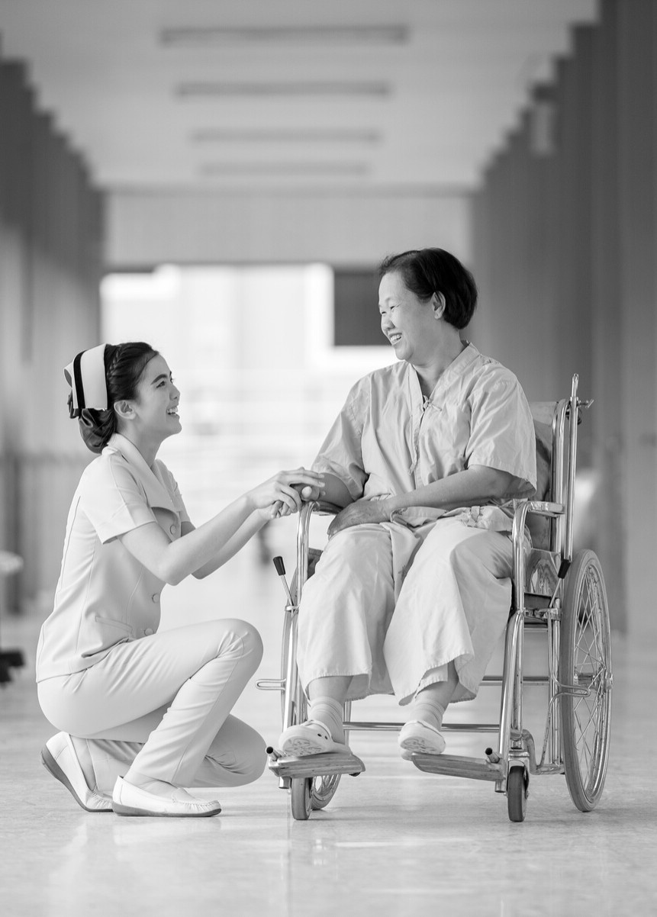


SOLUTIION
OUR
It takes the personal details and health condition of the patient and their hospital preferences Based on the patient's preference(public or private) and their health issue, the application displays a list of hospitals.

Slide 8



This list can be sorted out based on the traffic condition at that time.
They can select a hospital and share the details of the patient to the hospital beforehand and can see the directions to the hospital.
If the patient wants to reserve a bed(optional), they
can pay some minimum amount.
When the bed is reserved, the hospital also gets to know about the patient and the staff will be ready.

